Slide 1
DATA PROGRAMMING BDAT-1004 FINAL GROUP PROJECT
Priya jogani : 200523921
Suheet sonawane : 2004923886
Igor labuzov : 200548946
Samarpan pandey : 200492080 Group: 1

Slide 2
SCOPE OF PROJECT
A MULTINATIONAL CORPORATION XYZ WANTS TO ASSESS OUR TEAMWORK AGAINST OUR COMPETITORS IN GAINING FOR A 5-YEAR CONTRACT. WE ARE SUPPOSED TO:
ACQUIRE DATA FROM A URL USING PYTHON AND STORE IT IN A DATABASE
USE PYTHON TO RUN A PSEUDO-BATCH PROCESS EVERY 24 HOURS
DISPLAY RESULTS ON A WEBSITE, AND
BUILD AN API – TO DISTINGUISH OURSELVES FROM COMPETITORS

Slide 3




OUR GROUP PROJECT TEAM
PRIYA JOGANI SUHEET SONAWANE IGOR LABUZOV SAMARPAN PANDEY
PROJECT MANAGER DEVELOPER BUSINESS ANALYST DATA ANALYST

Slide 4
DATASET AND PROJECT DESCRIPTION
THE DATASET SELECTED PROVIDES STOCK MARKET CURRENCY RATES.
API USED TO CONNECT OUR DATA: https://cryptingup.com/api/markets
IN OUR PROJECT WE ARE REFLECTING THE TRENDS OF THE STOCK MARKET.

Slide 5
METHODOLOGY
SOFTWARE: MongoDB, Python, PowerPoint
LIBRARIES: Flask, Mongo, appScheduler other essential python libraries.
We use MongoDB as a cloud database management system. The database relates to Python using PyMongo library. Our database is getting updated every 24 hour through a app scheduler, which reflects changing rates of stock over a day.
For Visualization, We are using Javascript library such as Chart.js along with HTML, CSS for front-end.

Slide 6
PROCESS DESCRIPTION
The dashboard is the user access tool through which user can visit different URLs which will redirect him to the stock market prices or benchmark prices for different stock markets in the tabular form. The design and development of the dashboard are all done in python and javascript by using the microframework named flask.
After the user clicks on the URL the data is fetched and stored at the backend. The connection to the backend is done using mongodb which fetches the data from the URLs and save to the backend tables in mySQL. The data on the server side will be stored in the mongodb which is cloud-based data server.

Slide 7
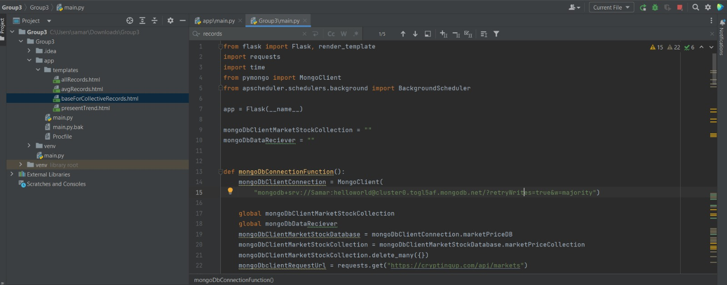
client and api to connect with our data and get data for our database

Slide 8
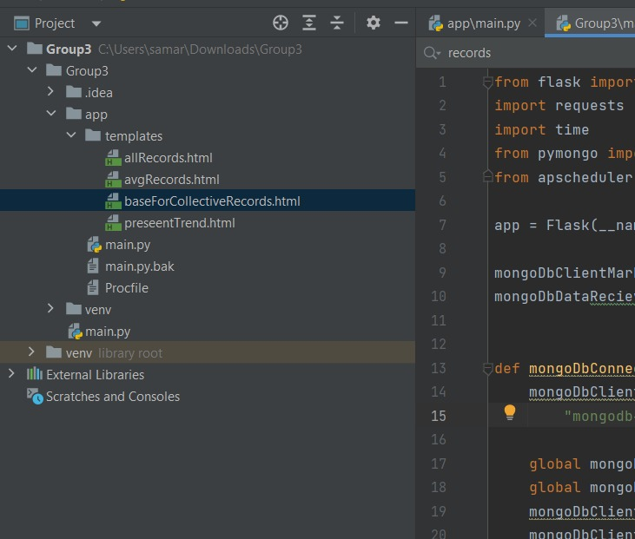
Project files and javascript files

Slide 9
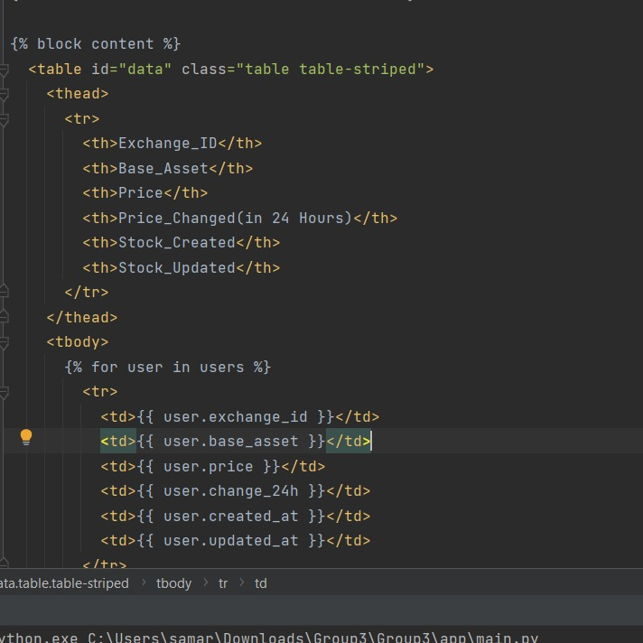
JAVASCRIPT FOR FRONT END

Slide 10
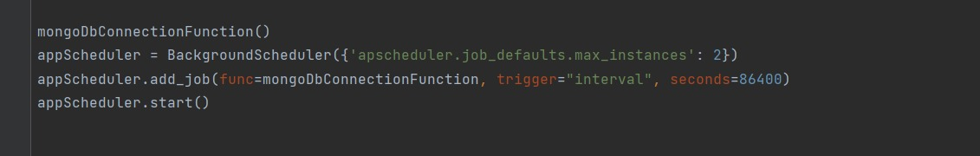
24-HOUR SCHEDULING through backgroundscheduler

Slide 11
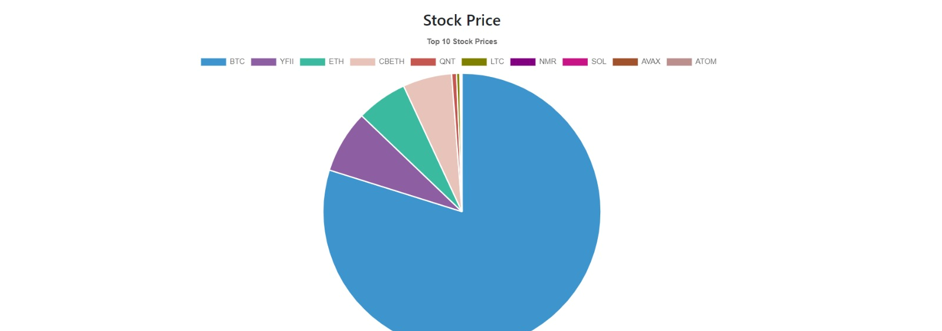
stock prices through pie chart, bitcoin at highest as we CAN SEE AT THAT PARTICULAR MOMENT

Slide 12

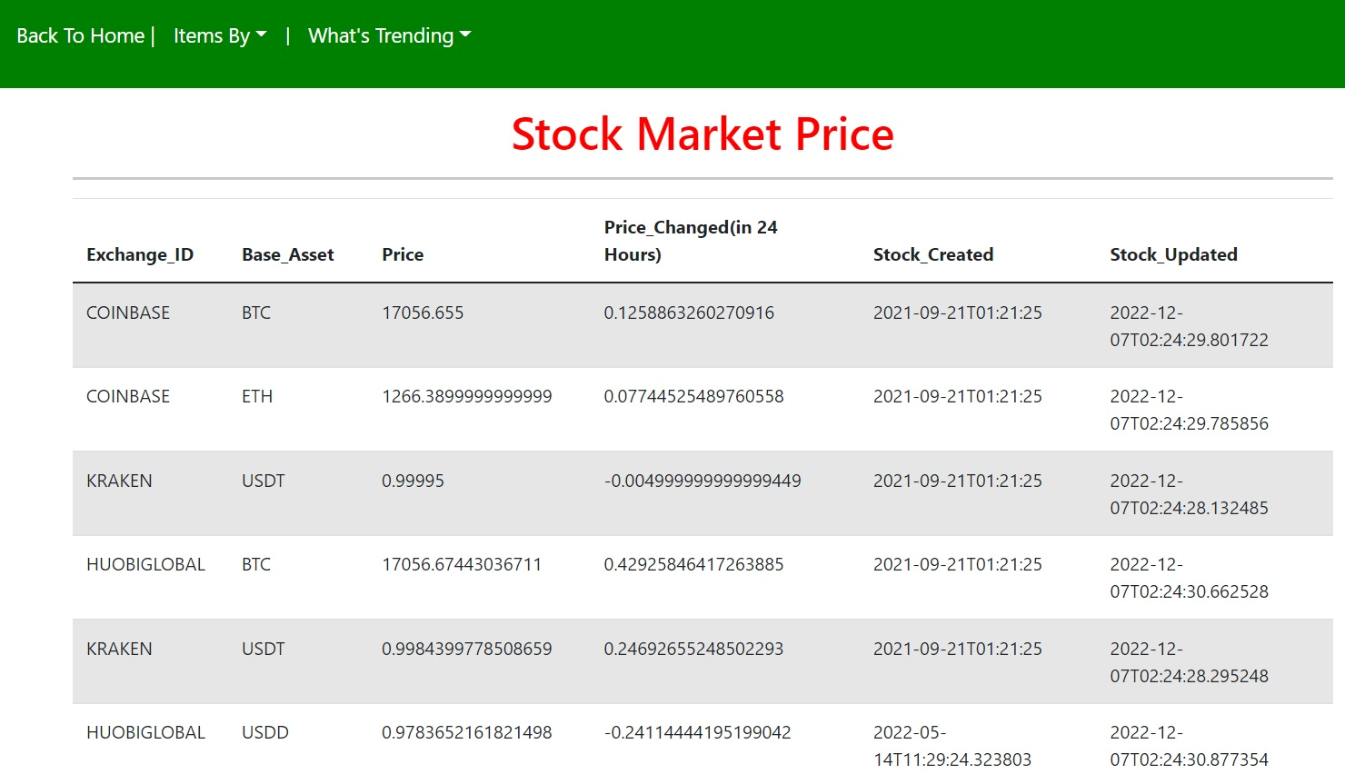
stock prices with stock update times, which are getting updated every 24- hour as requested by client

Slide 13
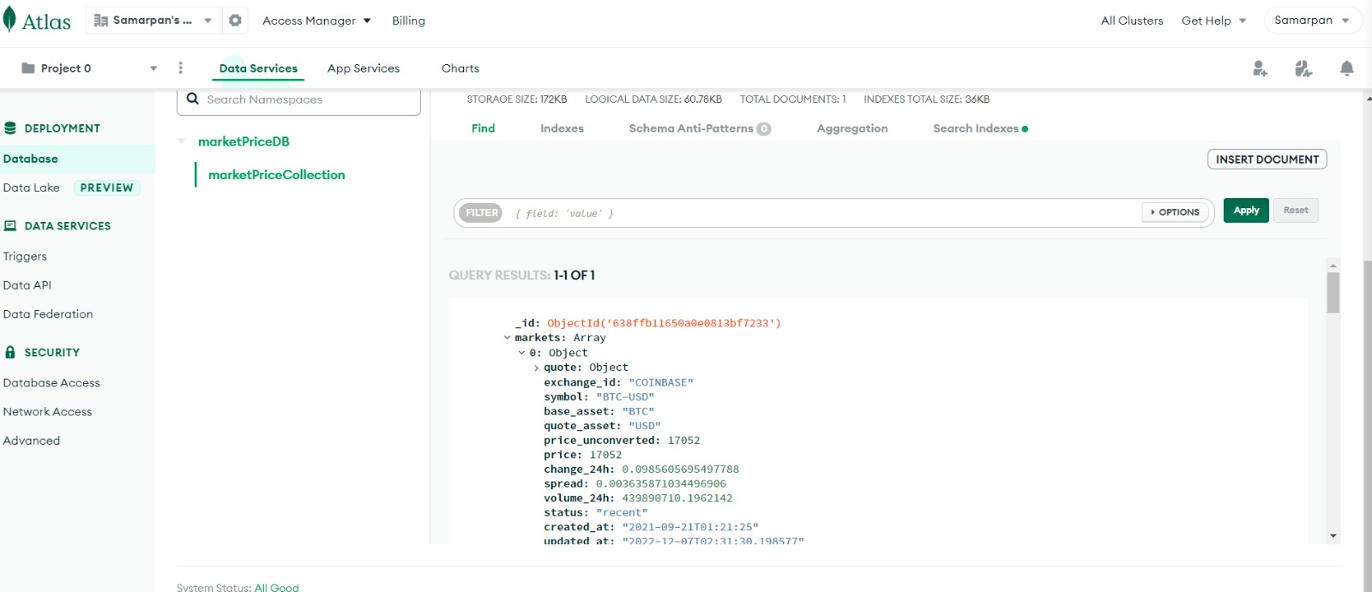
database updated through api in our mongodb database

Slide 14
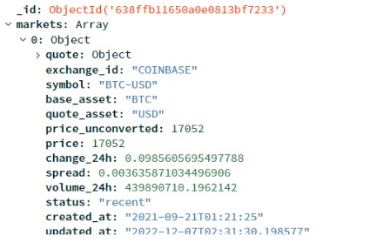
For the Bonus part, we have performed a connection through API and got all the items in objects in our mongoDB database. The items have different ids which are stored in objects as can be seen in the image Above.

Slide 15
Thank You!
Any Feedback would be greatly appreciated.

